Slide 1

“STOCK INVENTORY
WEBSITE”
Task - 3

Slide 2

STOCKꢀINVENTORYꢀWEBSITE
Stock Inventory website stores the product details
stock. It provides the interface to users to man
transaction and the previous data. It maintenanc
about the monthly inwards ,monthly returns
deliveries.
LMS Username
2115a91
Name
AARTHY.K
Batch
A9
2115a92
AASHA.M
A9
A9
A9
2115a916
2115a946
DHANU SRI M.R
SNEGAA.S

Slide 3

Taskꢀ3ꢀ::ꢀFrontendꢀCreation
CreateꢀvariousꢀFrontꢀEndꢀPrograms
● Drawꢀandꢀdesignꢀaꢀuniformꢀfrontꢀendꢀcodeꢀforꢀ“YourꢀProject”
● Drawꢀandꢀdesignꢀaꢀinteractiveꢀfrontꢀendꢀcodeꢀforꢀ“YourꢀProject”
Evaluation Metric:
100%ꢀCompletionꢀofꢀtheꢀaboveꢀtasks
Learningꢀoutcome
▪ DevelopingꢀcomplicatedꢀUIꢀusingꢀHTMLꢀcomponents
▪ Usingꢀpropsꢀdrillingꢀandꢀcontextꢀtoꢀpassꢀvariables
▪ Gettingꢀfamiliarꢀwithꢀdifferentꢀtypeꢀofꢀapiꢀcalls
▪ Handlingꢀdifferentꢀinputꢀdata

Slide 4
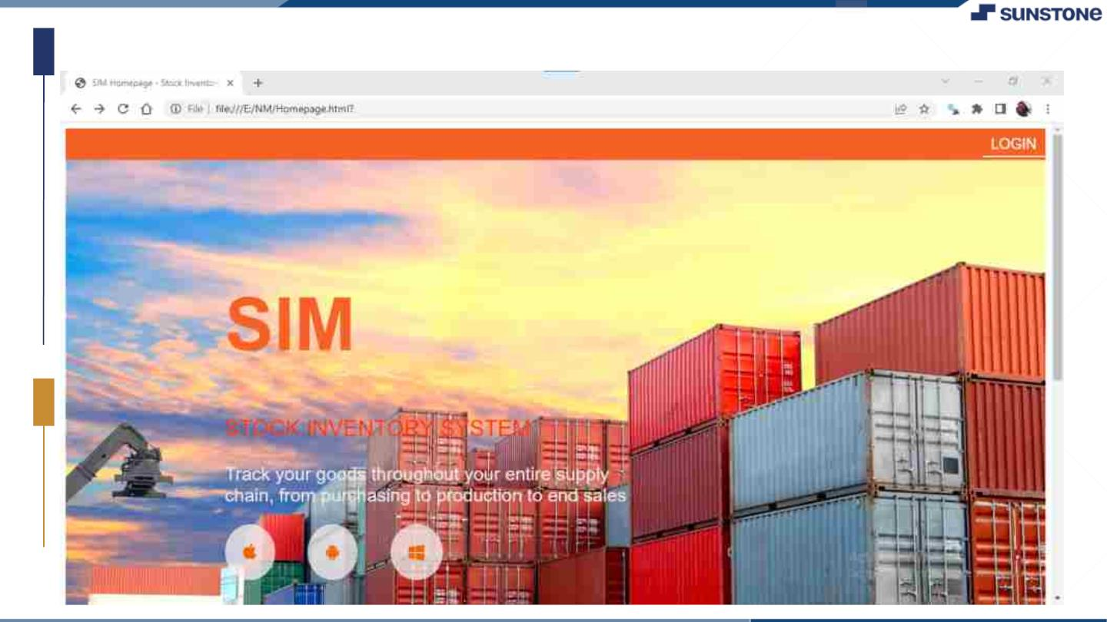
OUTPUT:

Slide 5
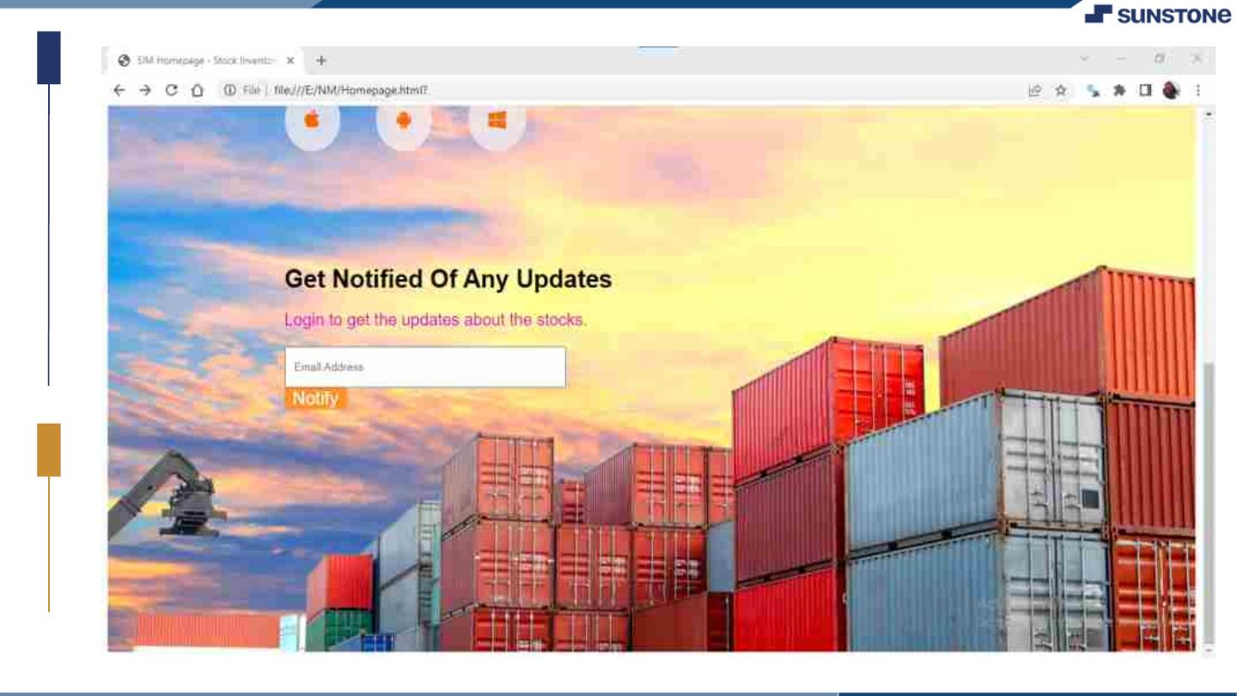

Slide 6
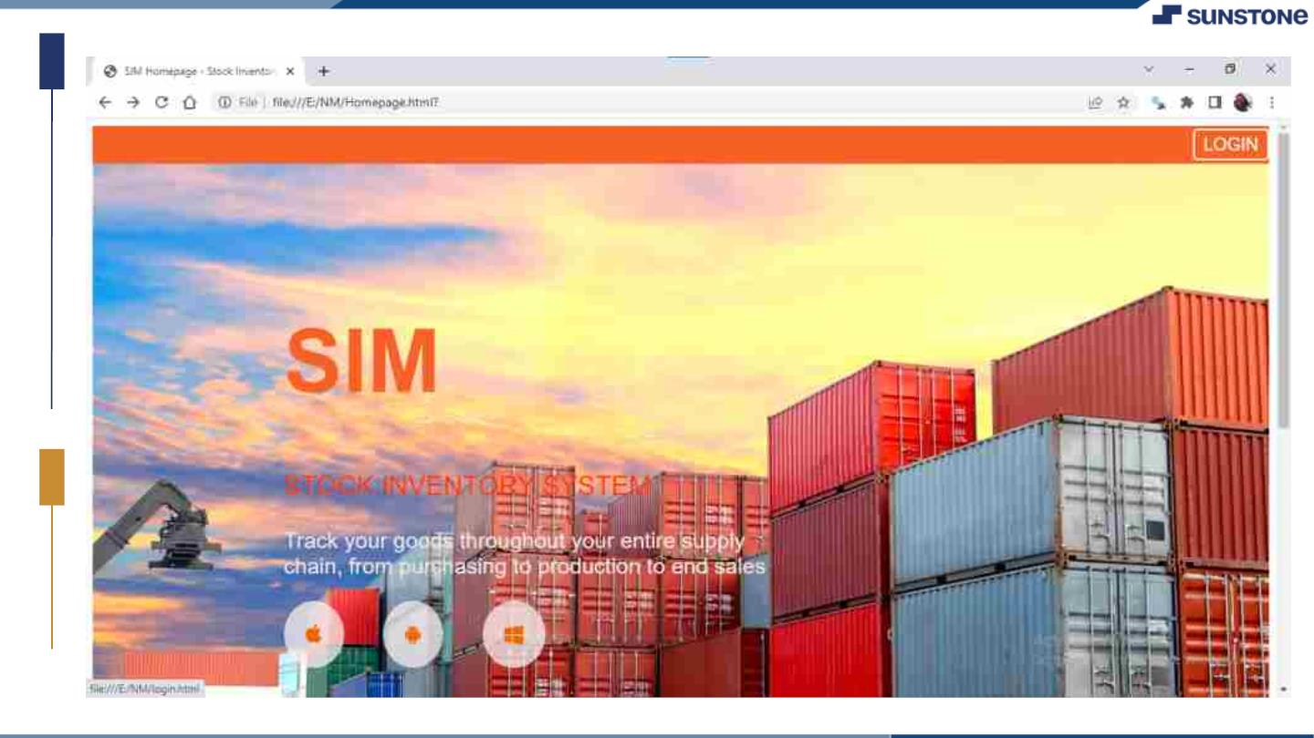

Slide 7
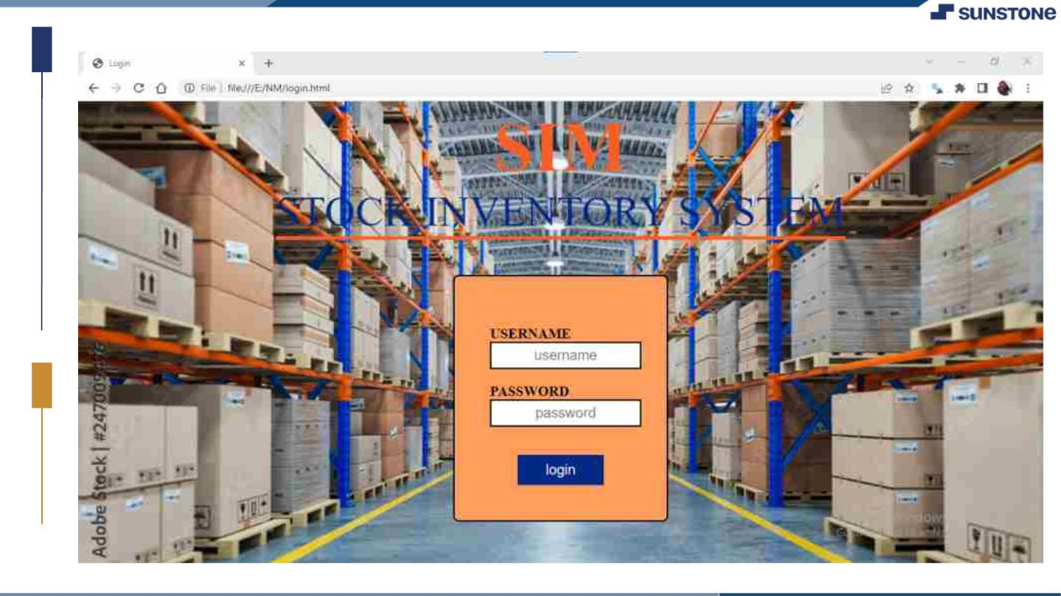

Slide 8
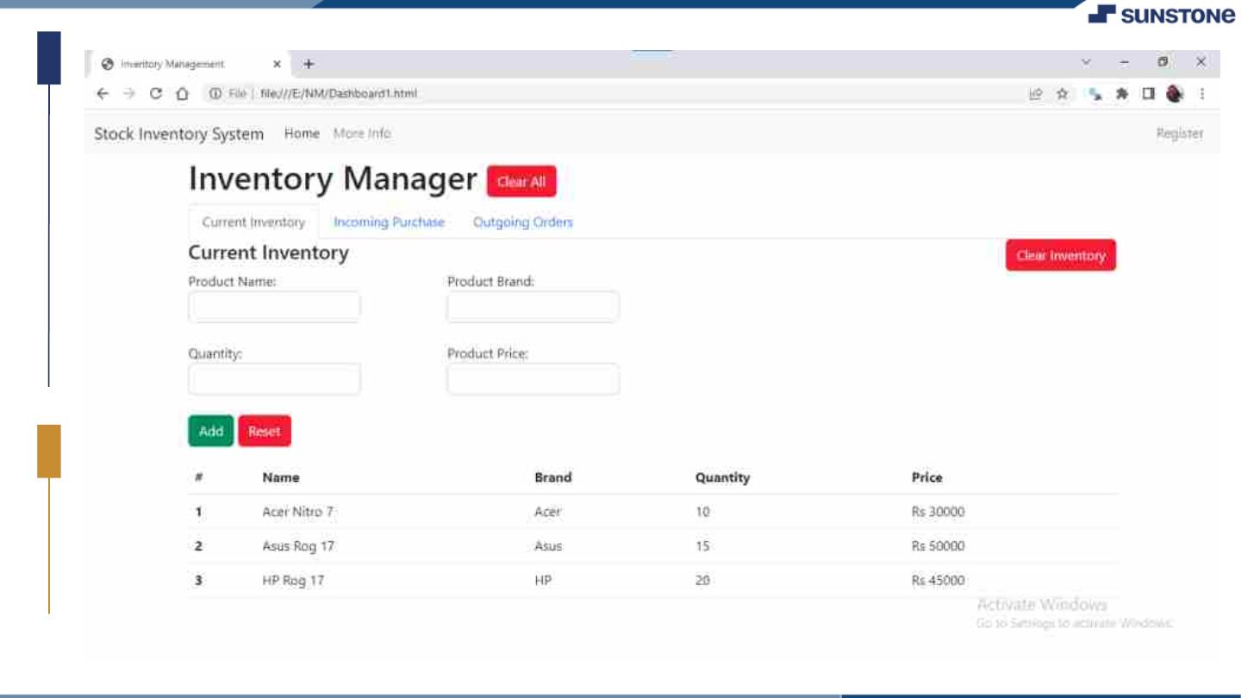

Slide 9

AssessmentꢀParameter
Createꢀfolderꢀstructureꢀforꢀ
HTMLꢀꢀapplication
RenderꢀConditionalꢀ
components
WriteꢀFunctionsꢀforꢀeventꢀhandling
Check-List
OverallꢀUIꢀofꢀtheꢀproject
Handlingꢀbrokenꢀlinks
Optimizingꢀrenderꢀcycle

Slide 10

Submission Github
https://github.com/aarthy03/
Stock-Inventory-Website

Slide 11


